Slide 1

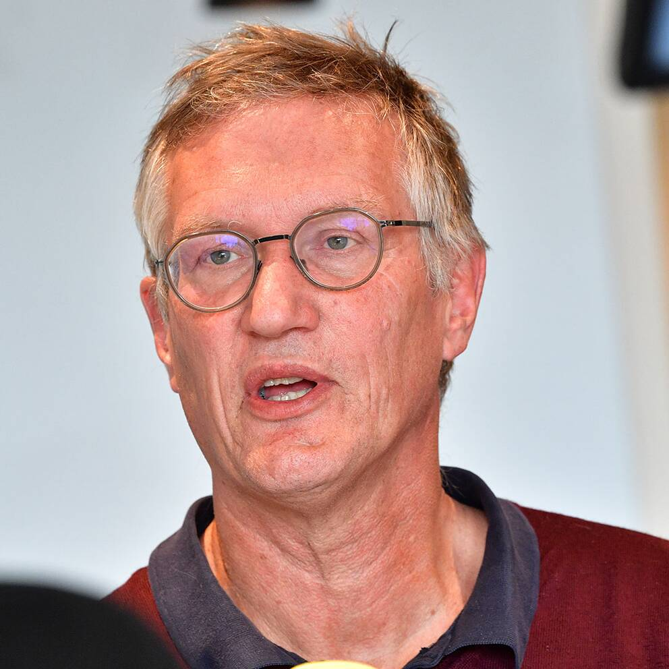
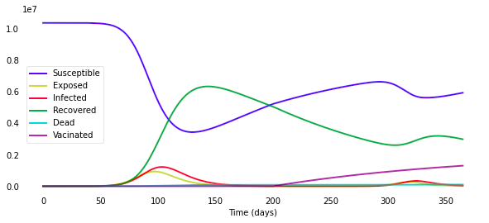
q
Covid-19:
When will it end?
Brought to you by poor students
Notes:
The current pandemic has made an impact for all of us in many different ways. As a way to handle this we've seen the introduction of various preventive measures that both affect us as individuals and as a society. We've also seen the importance of mathematical modeling to not only try to predict the future but also to understand what has happened, and display what's happening in the present.

Slide 2
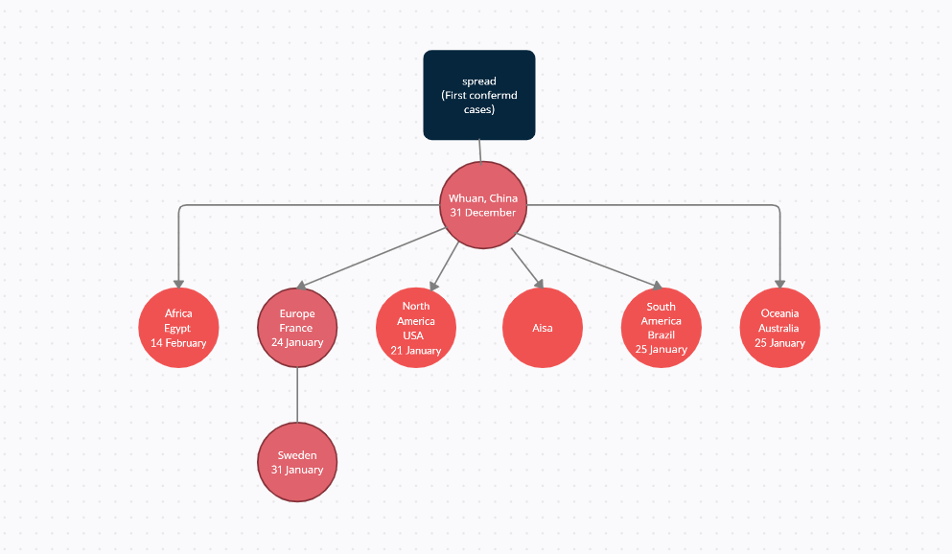
Notes:
As we all know the pandemic started in China and in the city of Whuan in december of 2019. Since then the virus has spread to every continent and it made its way to europe in january the following year. The first documented case in sweden came soon after that on the
31 of january in the city of Jönköping.

Slide 3
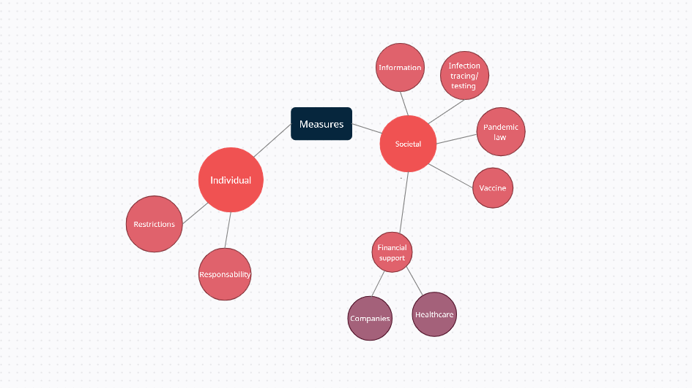
Notes:
We have tried to cover the most important aspects of Sweden's work related to the pandemic. We have categorised the measures in two categories: individual and societal. Individual measures are actions you do yourself, and societal measures are interventions made by the society, such as measures made by the government for example.

Slide 4
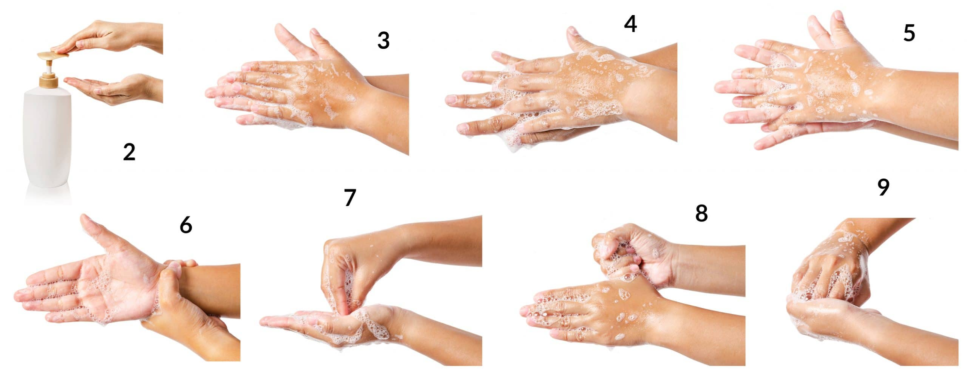
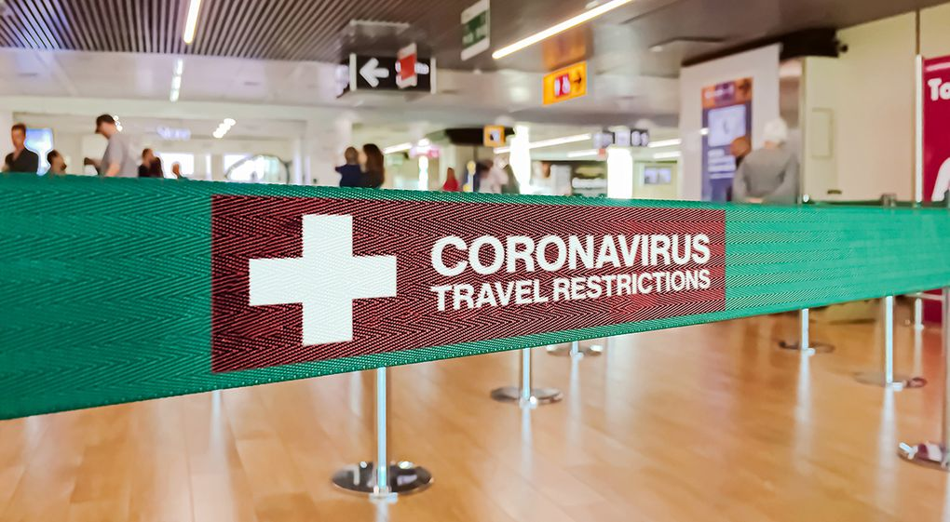
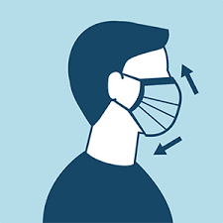
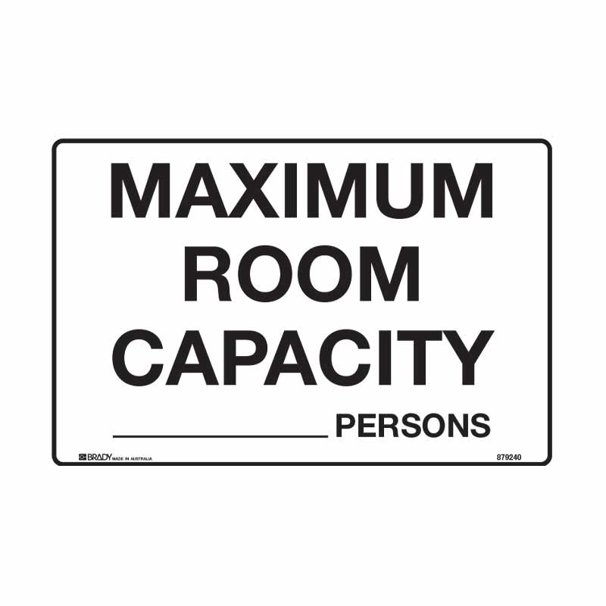
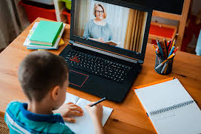
Interventions - Individual
Restrictions - Responsibility
Notes:
Individual measures can either be following restrictions, or taking responsibility by choosing to do certain actions. Traveling bans, working /studying from home, and quarantine are examples of restrictions. Washing your hands, keeping distance,wearing a mask and staying home when you have symptoms are examples of taking responsibility.

Slide 5

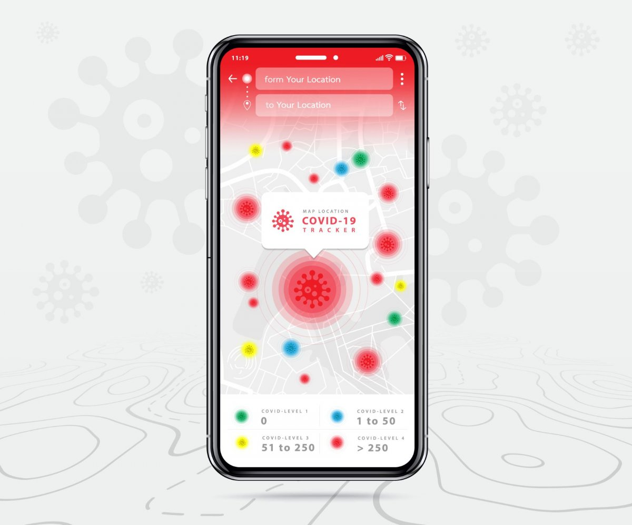

Interventions - Societal
Interventions - Societal
Notes:
One of the interventions that often go overlooked is The constant flow of updates and information regarding the pandemic that we see on the news. The swedish government clearly states that this is very important cause calms the public down
Other interventions are general infection tracing and introducing laws as a consequence of the pandemic

Slide 6
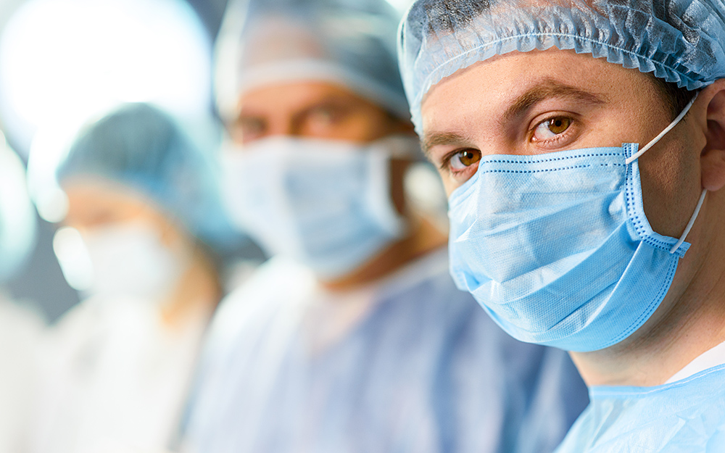
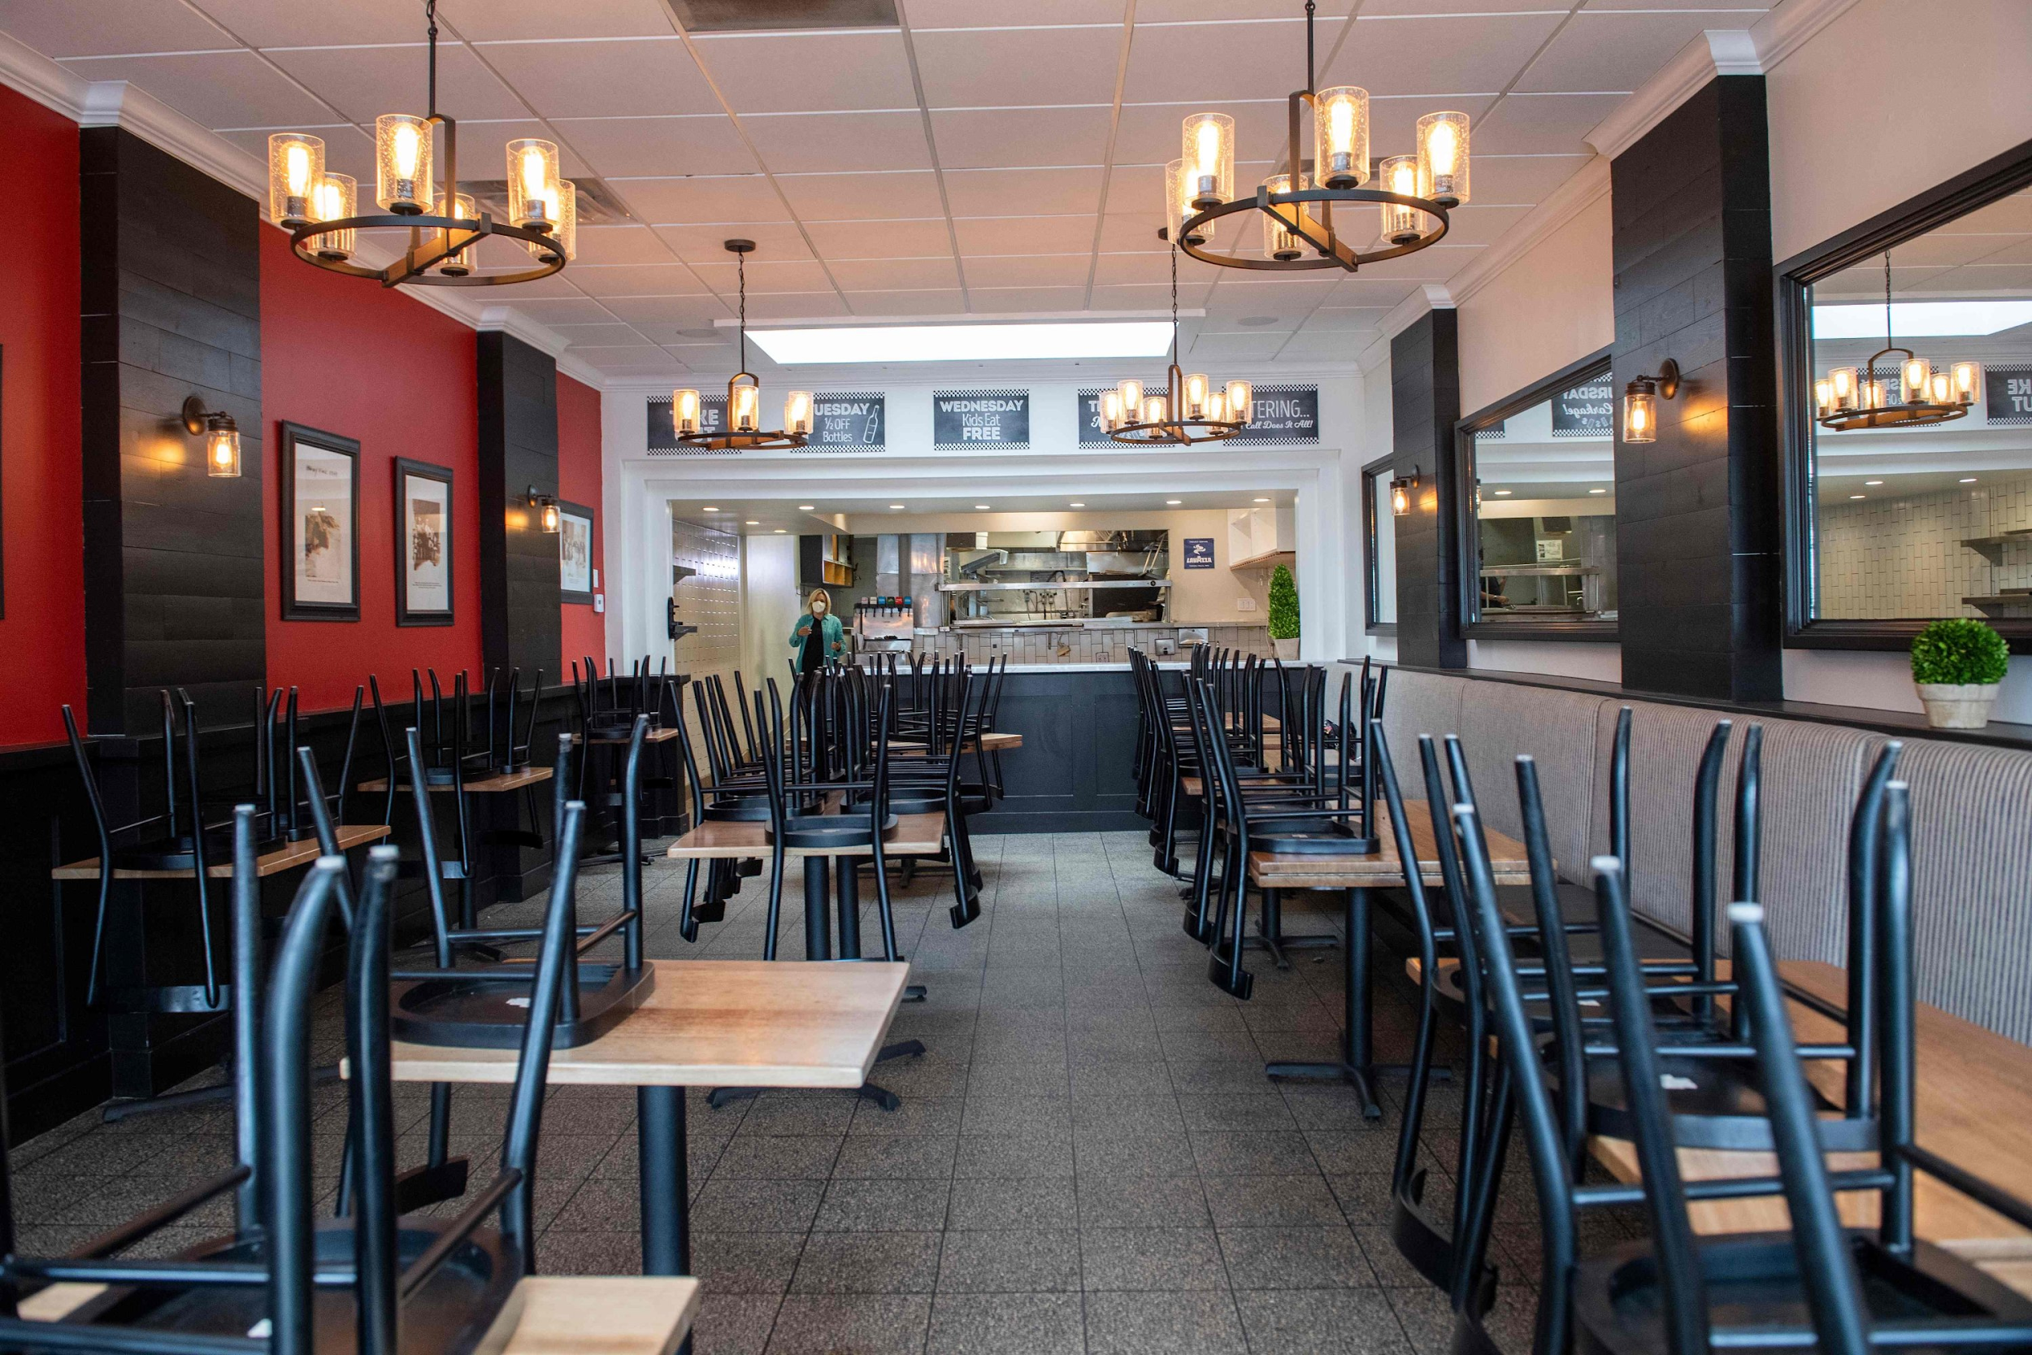
Interventions - Financial Support
Notes:
In sweden, financial support from the government are mainly prioritized to the activities most important to society.
Support has been given to the health care. Extra costs at hospitals, such as extra employees and equipments, have been financed by the government. Financial support has also been given to companies and organisations that struggles due to the pandemic.

Slide 7
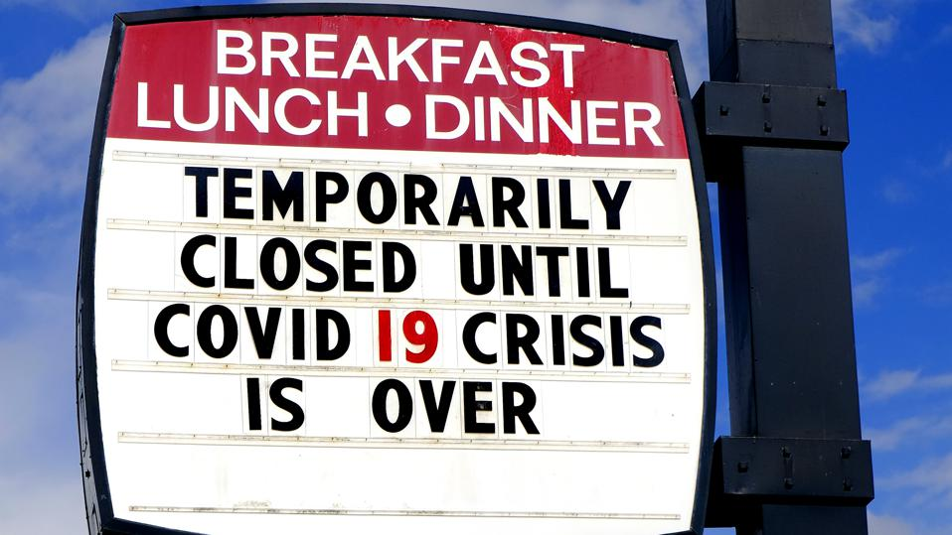
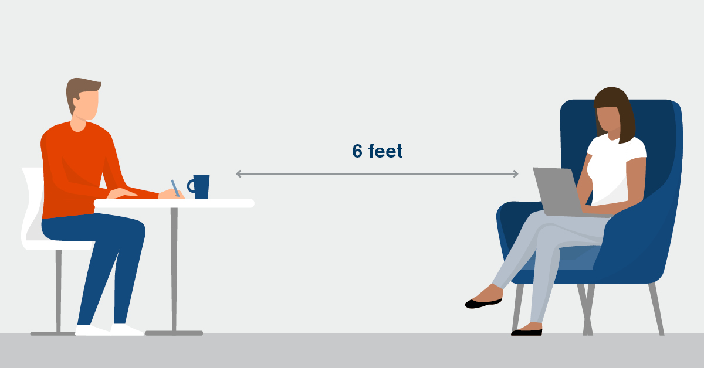
Sammanfattning, spridning samt åtgärder
Summary
Individual/Societal measures
Notes:
We can now see that the interventions that affect the public on a more individual level came early on in the process, such as social distancing and washing our hands. Later on we've experienced more societal measures such as the introduction of a pandemic law. Worth mentioning is that Sweden has not had a lockdown like the UK and other countries.

Slide 8
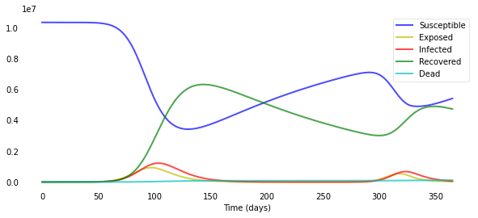
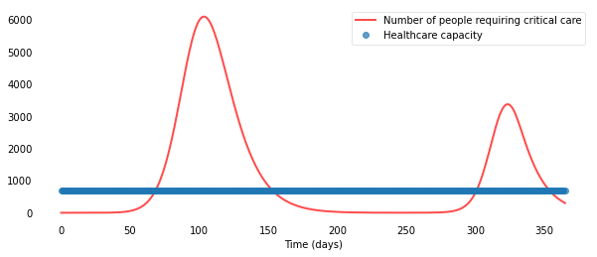
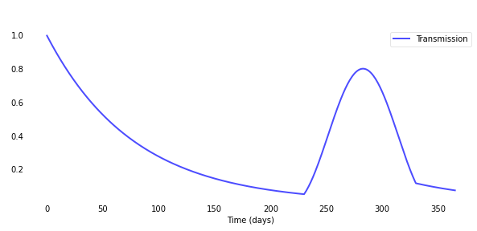
Modeling Our first model
Modified the function to behave like a sine curve for a given interval to simulate a second wave
Notes:
When it comes to the modeling we chose to extend the SIR model we got to a SEIRD-model by simply adding a death and exposed compartment. We also added: a time varying transmission rate (perhaps due to seasons or people’s willingness to follow the recommendations), lost immunity and a healthcare capacity plot showing the number of spots at the intensive care unit.

Slide 9
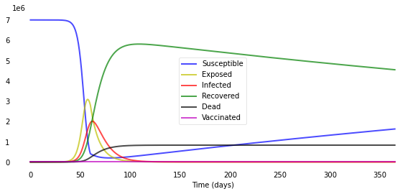
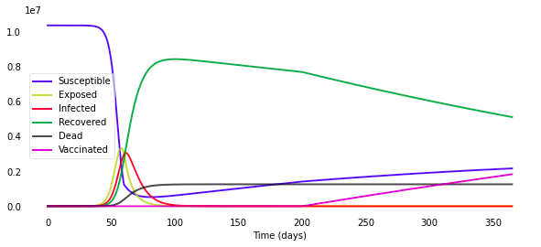
Group 15’s Model
Without vaccination
With vaccination
Notes:
We examined group 15’s model, also a SEIRD-model but with vaccination and lockdown. And when playing with the vaccination variables we found something rather interesting. Which is, that for the number of infected it doesn’t really make any difference whether we introduce a vaccine or not. We will find a decrease in the number of susceptible, exposed and recovered but infected will stay the same.

Slide 10
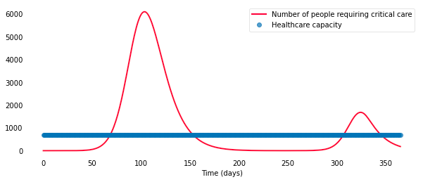
Combination of our model and group 15’s
Notes:
We therefore thought it could be interesting to combine our models, our second wave with their vaccination compartment, since a model as such would be able to tell the effectiveness of a vaccine and whether vaccination could stop a potential second wave. And from what we could see, a vaccine is pretty much unable to stop a second wave but it will flatten the curve, the more if presented at an early stage.

Slide 11
Model analysis
 | Vaccinated / Unvaccinated | Vaccinated / Unvaccinated | Vaccinated / Unvaccinated | Vaccinated / Unvaccinated
Day | 60 | 160 | 260 | 360
Deaths | 500 / 500 | 83000 / 83000 | 85000 / 85000 | 102000 / 119000
Vaccinated | 0 / 0 | 0 / 0 | 612000 / 0 | 1,27 million / 0
Infected | 48000 / 48000 | 89000 / 89000 | 333 / 407 | 52000 / 89000
Notes:
Analyzing two different cases with the last mentioned model, one without vaccination and one in which a vaccination program begann 100 days before the second wave, we can see that the total number of deaths after the second wave dropped with approximately 14% and the amount of deaths from the wave itself dropped with approximately 50%.

Slide 12
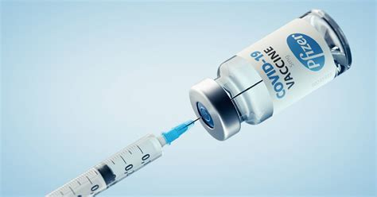
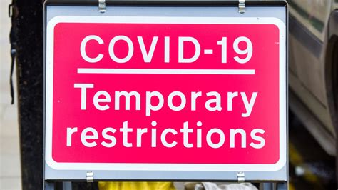
Conclusions from the Modeling
Gives an idea of how many lives vaccine can save
Inventing a vaccine in combination with restriction probably could have prevented more deaths.
+
Notes:
In short, the model shows what impact vaccine can have and how many lives it can save. Not many were vaccinated during the second wave but still many lives were spared. Furthermore, it also shows that even though vaccine saves a lot of lifes when implemented we still need restrictions before that to save many lives. In the model we don’t have a parameter for restrictions which resulted in a lot of deaths before the vaccine was available.
Vaccin hjälper:
Dra parallell till verkligheten. Färre som dör eftersom man riktar in sig.
Men enl. modellerna har de flesta redan dött innan vaccinet kommer. Därför viktigt att hålla nere på spridningen innan man får tillgång till vaccin.

Slide 13
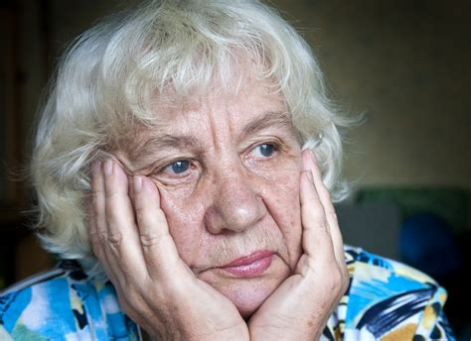
Thoughts about our results
Somewhat simplistic model
Spread among different age groups?
Targeting vaccination?
Notes:
Of course, we aren’t epidemiologists and it’s a simplistic model which we are analysing. For example our reproduction number is based on an estimation and in addition our model is missing out on important parameters which would have affected the result. For example how the disease is being spread among different age groups and how the result of the vaccine would’ve changed with a vaccination program which targets risk groups.
kritik mot modellerna:
Man kan i förväg inte veta hur mycket beta kommer att förändras
Ger överskattningar (antal infekterade ackumuleras)
Tar inte hänsyn till ålder (hade kanske varit intressant att veta när man ska utforma åtgärder t.ex. när man ska bestämma vilka åtgärderna ska gälla för) Finns ju ett samband mellan ökad dödlighet och högre ålder. Barn bidrar inte så mycket till smittan och blir inte lika sjuka, så hjälper det verkligen att sätta in restriktioner som rör den målgruppen? osv
Men bra för att se samband (vilka åtgärder hjälper, underlag vid beslutsfattningar)

Slide 14

How this affects our Walk and Talk conclusions
3 aspects of our new lives during the covid pandemic
Freetime
Work/School
Healthcare
Notes:
Moving on! During our Walk and Talks we saw that the pandemic has changed our way of living. In general to a way in which we don’t interact with as many people so the spread of disease would decrease. We will look further into which effects the pandemic has had on our freetime, work/school life and healthcare. If possible we will also link this to what we presented in either our concept map or in the modell.

Slide 15
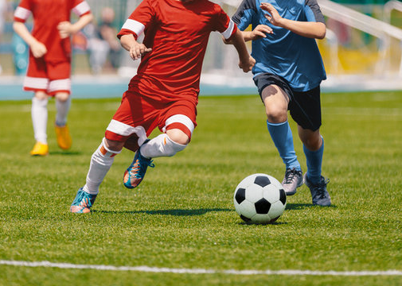
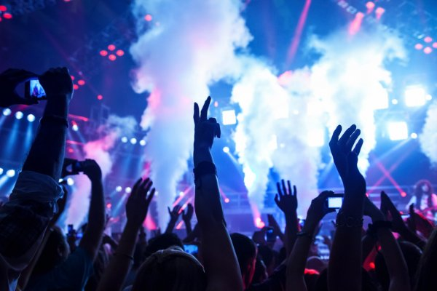
Freetime - What has been taken from us?
Notes:
Some events are difficult to fulfill during the pandemic without breaking rules about gatherings and social distancing, and this is why some events, such as sports events and concerts, can not take place. This is something we noticed during our Walk and Talks. Sports and entertainment are not prioritized by the government financially.

Slide 16
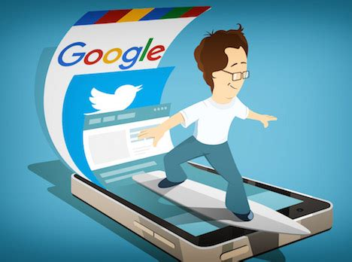
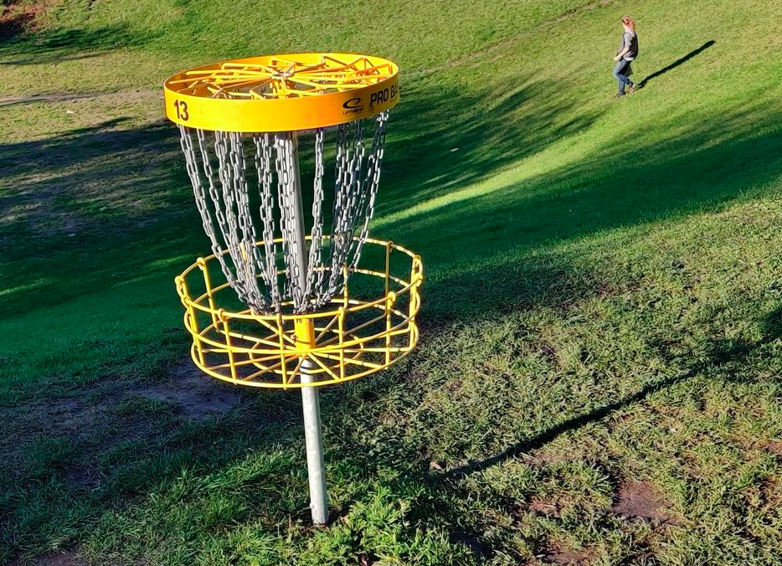

Freetime - How we adapted
Notes:
However, in Sweden we have been very adaptable and many have found new ways to spend our freetime in which we can keep our distance and/or stay at home such as hiking, playing discgolf, baking or spending more time on the internet. The result on society level is that consumers spend their money elsewhere than before which affects some companies positive and others negative.

Slide 17

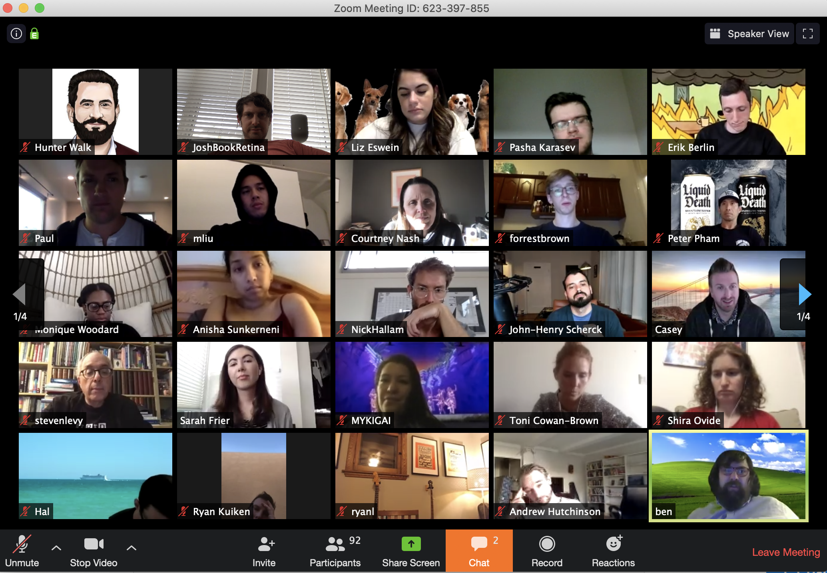
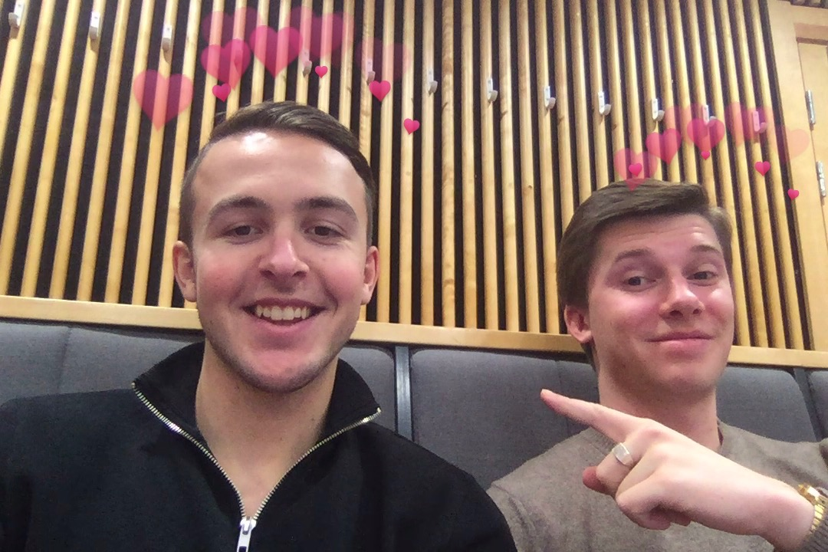
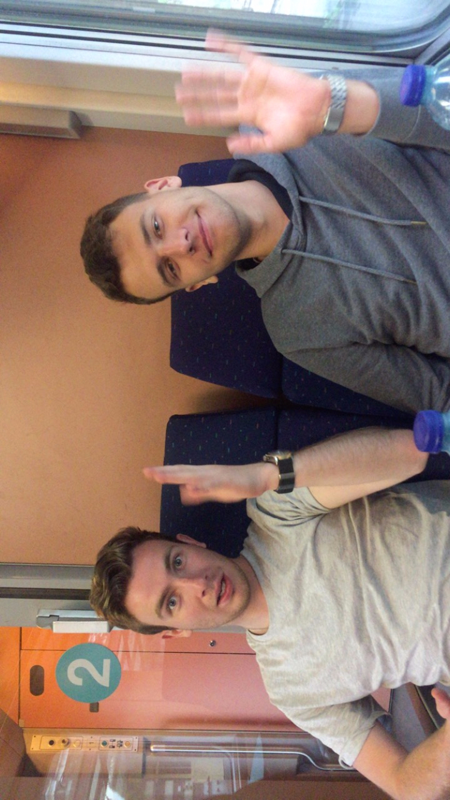


Work and School
Notes:
Many of us have experienced a significant change at work or at school due the pandemic. We have slowly but surely adapted to the usage of zoom and other similar services and it has in many cases become mandatory to be able to take part and manage a group activity online. This is a positive side effect of the pandemic that will most certainly affect the future

Slide 18
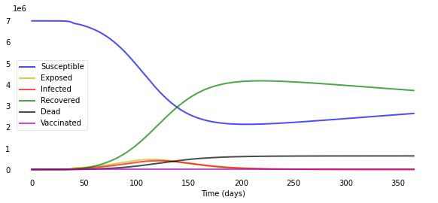
Retirement homes
Isolation ≈ Lockdown
Lockdown after 40 days
The curves for “Infected”, “Exposed” and “Dead” flattens
Notes:
During the walk and talk we got a glimpse of the isolated world of the elderlies. When the government imposed a visiting ban on the country’s retirement homes, it was like they put the residents under lockdown. Yes, they did so to prevent the spread and save lives, like group 15’s model shows us, but (as Azar said) how do we weigh that to the increased risk for depressions?
Which actually was the reason for the ban being lifted later on.

Slide 19
Pressure on healthcare systems
Exaggerated representation but important
Notes:
In the end though, it all comes down to the limits of the health care system. The purpose of many of these measures is to slow the spread of the disease and thereby reduce the burden on hospitals. We could see it in our models: a decreasing transmissions rate lowers the number of infected. We rely on the healthcare now more than ever, and that’s why it’s so important that it’s being prioritized.

Slide 20

Our most important observations are...
Notes:
Our most important observations with this project are the importance of functioning healthcare and the fact that we can not rely on a vaccin to completely stop the pandemic, but, it will save a lot of lives.
One thing we learned for sure is that the pandemic is not over yet, and restrictions and responsibility still matters.

